Slide 1
Budweiser Data Analysis Project
Reed & Miller Consulting

Slide 2
Brewery Count By State
Summary statistics
Total breweries counted = 558
Top 10 = ~51% of total count
Top 5 = ~31% of total count

Slide 3
Addressing Missing Data / NA’s
Only 2 of 10 categories evidenced missing data / NA’s.
Alcohol by volume of the beer (ABV) = 62 missing values (3% of total)
International Bitterness Units of the beer (IBU) = 1005 missing values (42% of total)
What will be done with this data?
For now we will keep them in the analysis but:
May need to be filtered out later to avoid misleading results.
May be removed if we can determine whether the data is missing at random or not

Slide 4
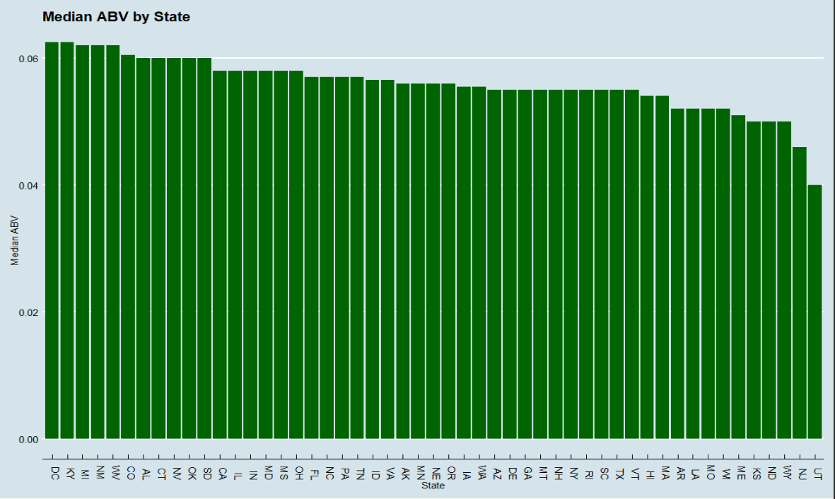
Median Alcohol By Volume (ABV)

Slide 5
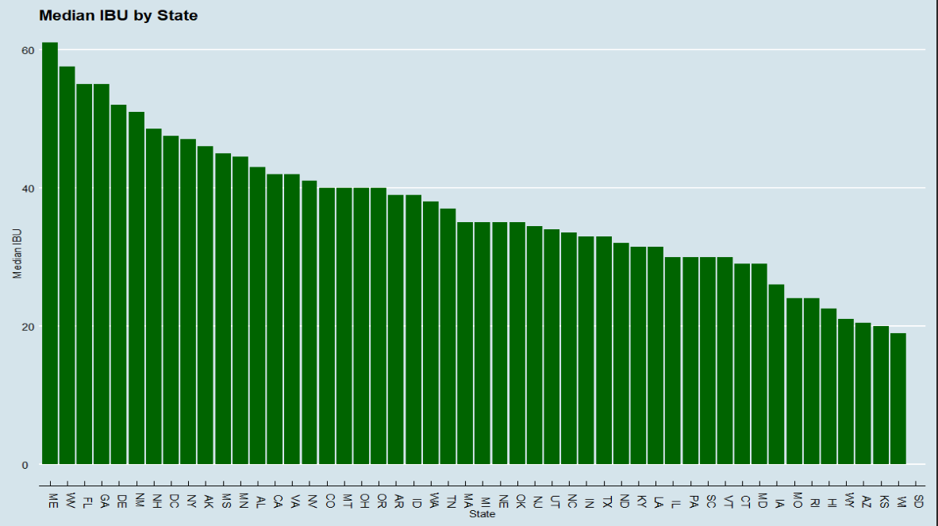
Median International Bitterness Units (IBU)

